Slide 1
Group #1: Sleepless developers
Andrey
Roman
Eugene
Project: Euclidean algorithm
Venus
Mentor: Sergei Melenevskyi

Slide 2
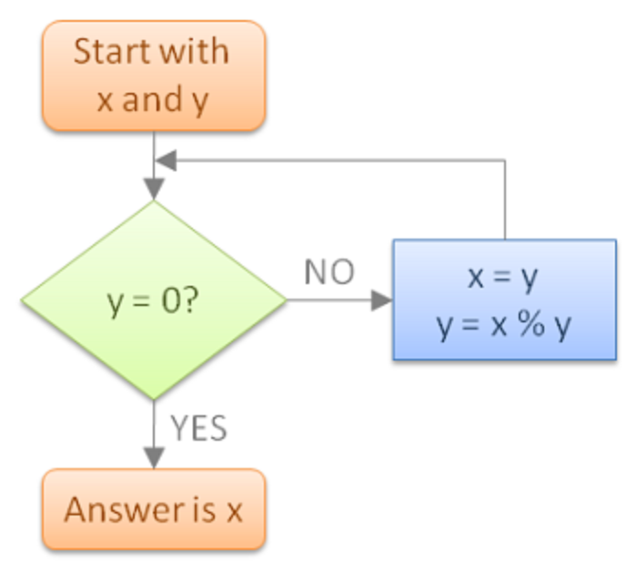
Euclidean algorithm description
Implementations of the algorithm in pseudocode:
function gcd(a, b)
while b ≠ 0
t := b;
b := a mod b;
a := t;
return a;

Slide 3
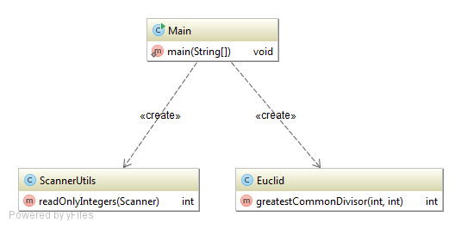
UML - diagram

Slide 4



Bibliography
https://docs.oracle.com/javase/7/docs/api/java/math/BigInteger.html
https://en.wikipedia.org/wiki/Euclidean_algorithm#Implementations
https://www.google.com ☺
http://stackoverflow.com/
https://www.techsmith.com/camtasia.html
Horstmann Cay S., Cornell G. "Core Java" Volume I and II, 9th edition
Eckel Bruce Thinking in Java, 4th edition / Prentice Hall, 2006.

Slide 5


